Slide 1
10 Things to Know about Adverse Childhood Experiences (ACEs)
Colleen M. Bridger, MPH, PhD
Assistant City Manager

Slide 2
1. Scored with a 10-question quiz
Graphic: Robert Wood Johnson Foundation, rwjf.org/aces

Slide 3
ACE Questionnaire
 | While growing up, during your first 18 years of life:
1. | Did a parent or other adult in the household often Swear at you, insult you, put you down, or humiliate you? Or Act in a way that made you afraid that you might be physically hurt?
2. | Did a parent or other adult in the household often Push, grab, slap, or throw something at you? Or Ever hit you so hard that you had marks or were injured?
3. | Did an adult or person at least 5 years older than you ever Touch or fondle you or have you touch their body in a sexual way? Or Try to or actually have oral, anal, or vaginal sex with you?
4. | Did you often feel that No one in your family loved you or thought you were important or special? Or Your family didn’t look out for each other, feel close to each other, or support each other?

Slide 4
Continued
5. | Did you often feel that You didn’t have enough to eat, had to wear dirty clothes, and had no one to protect you? Or Your parents were too drunk or high to take care of you or take you to the doctor if you needed it?
6. | Were your parents ever separated or divorced?
7. | Was your mother or stepmother: Often pushed, grabbed, slapped, or had something thrown at her, or Sometimes or often kicked, bitten, hit with a fist, or hit with something hard, or Ever repeatedly hit over at least a few minutes or threatened with a gun or knife?
8. | Did you live with anyone who was a problem drinker or alcoholic or who used street drugs?
9. | Was a household member depressed or mentally ill or did a household member attempt suicide
10. | Did a household member go to prison?

Slide 5
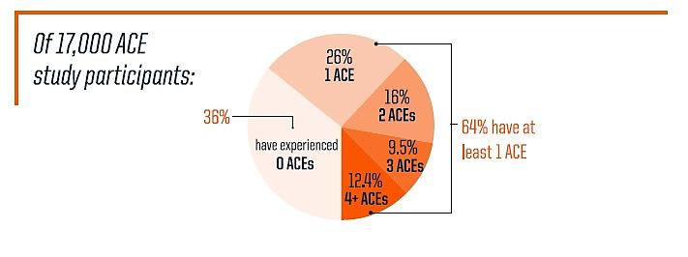
2. ACEs are common
Graphic: Robert Wood Johnson Foundation, rwjf.org/aces

Slide 6
3. ACEs cause toxic stress
Toxic Stress
(ex. chronic neglect) Strong, frequent and/or prolonged adversity, without enough adult support
Tolerable Stress
(ex. death in family) More severe. Buffered by adult support
Positive Stress
(ex. getting a shot)
Brief. Part of healthy development.
Graphic: kaboom.org

Slide 7
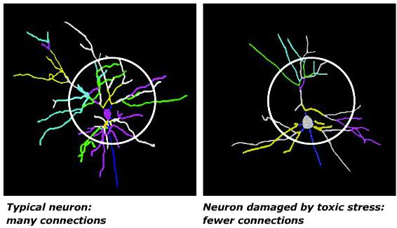
4. Toxic stress harms brain architecture
Children’s brains that are constantly bathed in “fight or flight” hormones start to wire differently
Neutral facial expressions may be interpreted as threatening
Fewer connections grow in “reasoning” section of brain
Weaker impulse control, shorter attention spans
Image: Orion Children International

Slide 8
5. …and the rest of the body too
Chronic stress sends white blood cells into overdrive (chronic inflammation)
Common unhealthy responses to toxic stress: smoking and alcohol abuse
Image: Miller et al., Biol Psychiatry 2009;65:734
8

Slide 9
6. This has broad impacts
Dose-response relationship with 40+ health outcomes
Graphic: Centers for Disease Control and Prevention

Slide 10
7 of the top 10 leading causes of death are associated with ACEs
 | Leading Cause of Death in US, 2015 | Odds Ratio
1 | Heart disease | 1.8
2 | Cancer | 1.4
3 | Accident
4 | Chronic lower respiratory diseases | 2.8
5 | Stroke | 2.1
6 | Alzheimer’s | 4.2*
7 | Diabetes | 1.4
8 | Influenza and Pneumonia
9 | Kidney disease
10 | Suicide | 3.3-12.2*
Odds Ratios associated with 4 ACEs (CDC 2017, Felitti 1998)
Data: MMWR; November 8, 2019; Vol.68; No. 44
*<enter other reference here, 3 or more ACEs>, and Nadine Burke Harris/Center for Youth Wellness

Slide 11
7 of the top 10 leading causes of death are associated with ACEs
 | Leading Cause of Death | Odds Ratio
1 | Heart disease | 1.8
2 | Cancer | 1.4
3 | Chronic lower respiratory diseases | 2.8
4 | Accident
5 | Stroke | 2.1
6 | Alzheimer’s
7 | Diabetes | 1.4
8 | Influenza and Pneumonia
9 | Kidney disease
10 | Suicide | 12.2*
Odds Ratios associated with 4 ACEs (CDC 2017, Felitti 1998)
Data: MMWR; November 8, 2019; Vol.68; No. 44
*<enter other reference here, 3 or more ACEs>, and Nadine Burke Harris/Center for Youth Wellness

Slide 12
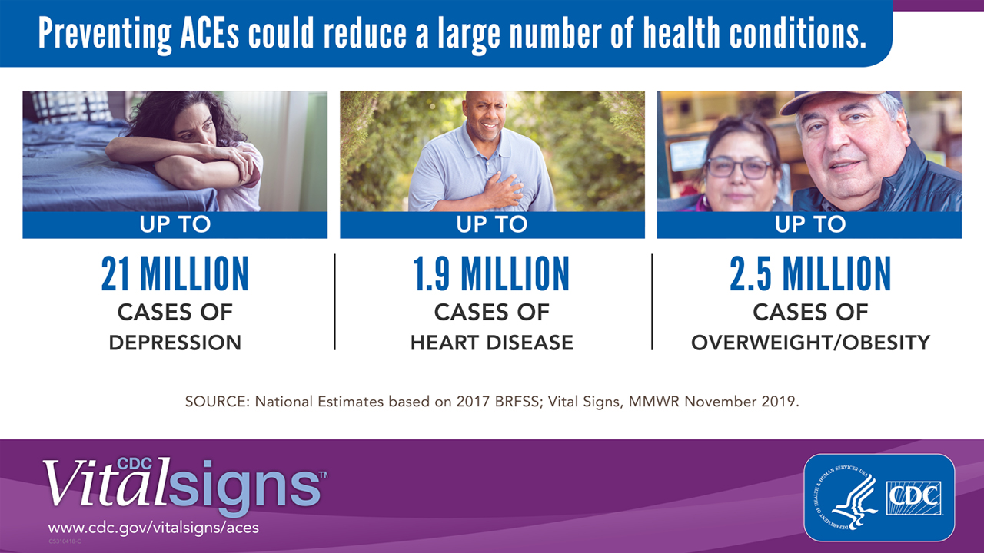
Power to Prevent
SOURCE: National Estimates Based on 2017 BRFSS: Vial Signs, MMWR November 2019

Slide 13
7. Effects may last generations
Trauma changes our cells on a deep level (the epigenome)
So do diet, exercise, lack of sleep, more
Epigenes affect how likely we are to suffer some illnesses
Can epigenetic changes from trauma be passed on to children and grandchildren? Stay tuned
Graphics: geneticalliance.org
13

Slide 14
8. We can overcome high ACEs
Good news: Trauma-induced changes (including epigenetic changes) are reversible
The brain is plastic, and the body wants to heal

Slide 15
Case Study: Walla Walla, WA
After four years of a trauma-informed approach at Lincoln High School:
Suspensions dropped 90%
Zero expulsions
Grades and graduation rates surged
Regardless of ACE score, teens with resilience thrived
15

Slide 16
9. How to create resilience
Reducing adversity
Safe, stable and nurturing relationships and environments
Sleep
Exercise
Nutrition
Mindfulness
Mental health
Photo: Thinkstock

Slide 17
10. What’s happening in San Antonio?
August 2018
South Texas Trauma-Informed Care Consortium is created
Institute for Trauma-Informed Care
October 2019
May 2019
Inaugural observance of Trauma-Informed Care Month
January 2020
Trauma-Informed Care Certifying Entity
17

Slide 18
Consortium Sector Workgroups
Education: Pre-K – 12
Early Care & Education
Higher Education
Child Welfare & Foster Care
Mental & Behavior Health
Medical, Hospitals, Clinics
Justice Systems
Local Gov’t & Strategic Communications
Philanthropy
Youth Development & Afterschool
Faith Based & Congregations
Family Support Services
Total Organizations = ~200

Slide 19
Institute for Trauma-Informed Care
Partnership between the City of San Antonio and University Health System
First year budget = $1.2 million
Provide training and technical assistance at no cost to organizations aspiring to become trauma-informed care certified

Slide 20
Certifying Entity
$150,000 grant from Methodist Healthcare Ministries
The Ecumenical Center will work with the Consortium and the Institute for Trauma-Informed Care to:
Develop certification standards
Assess and certify organizations as trauma-informed

Slide 21
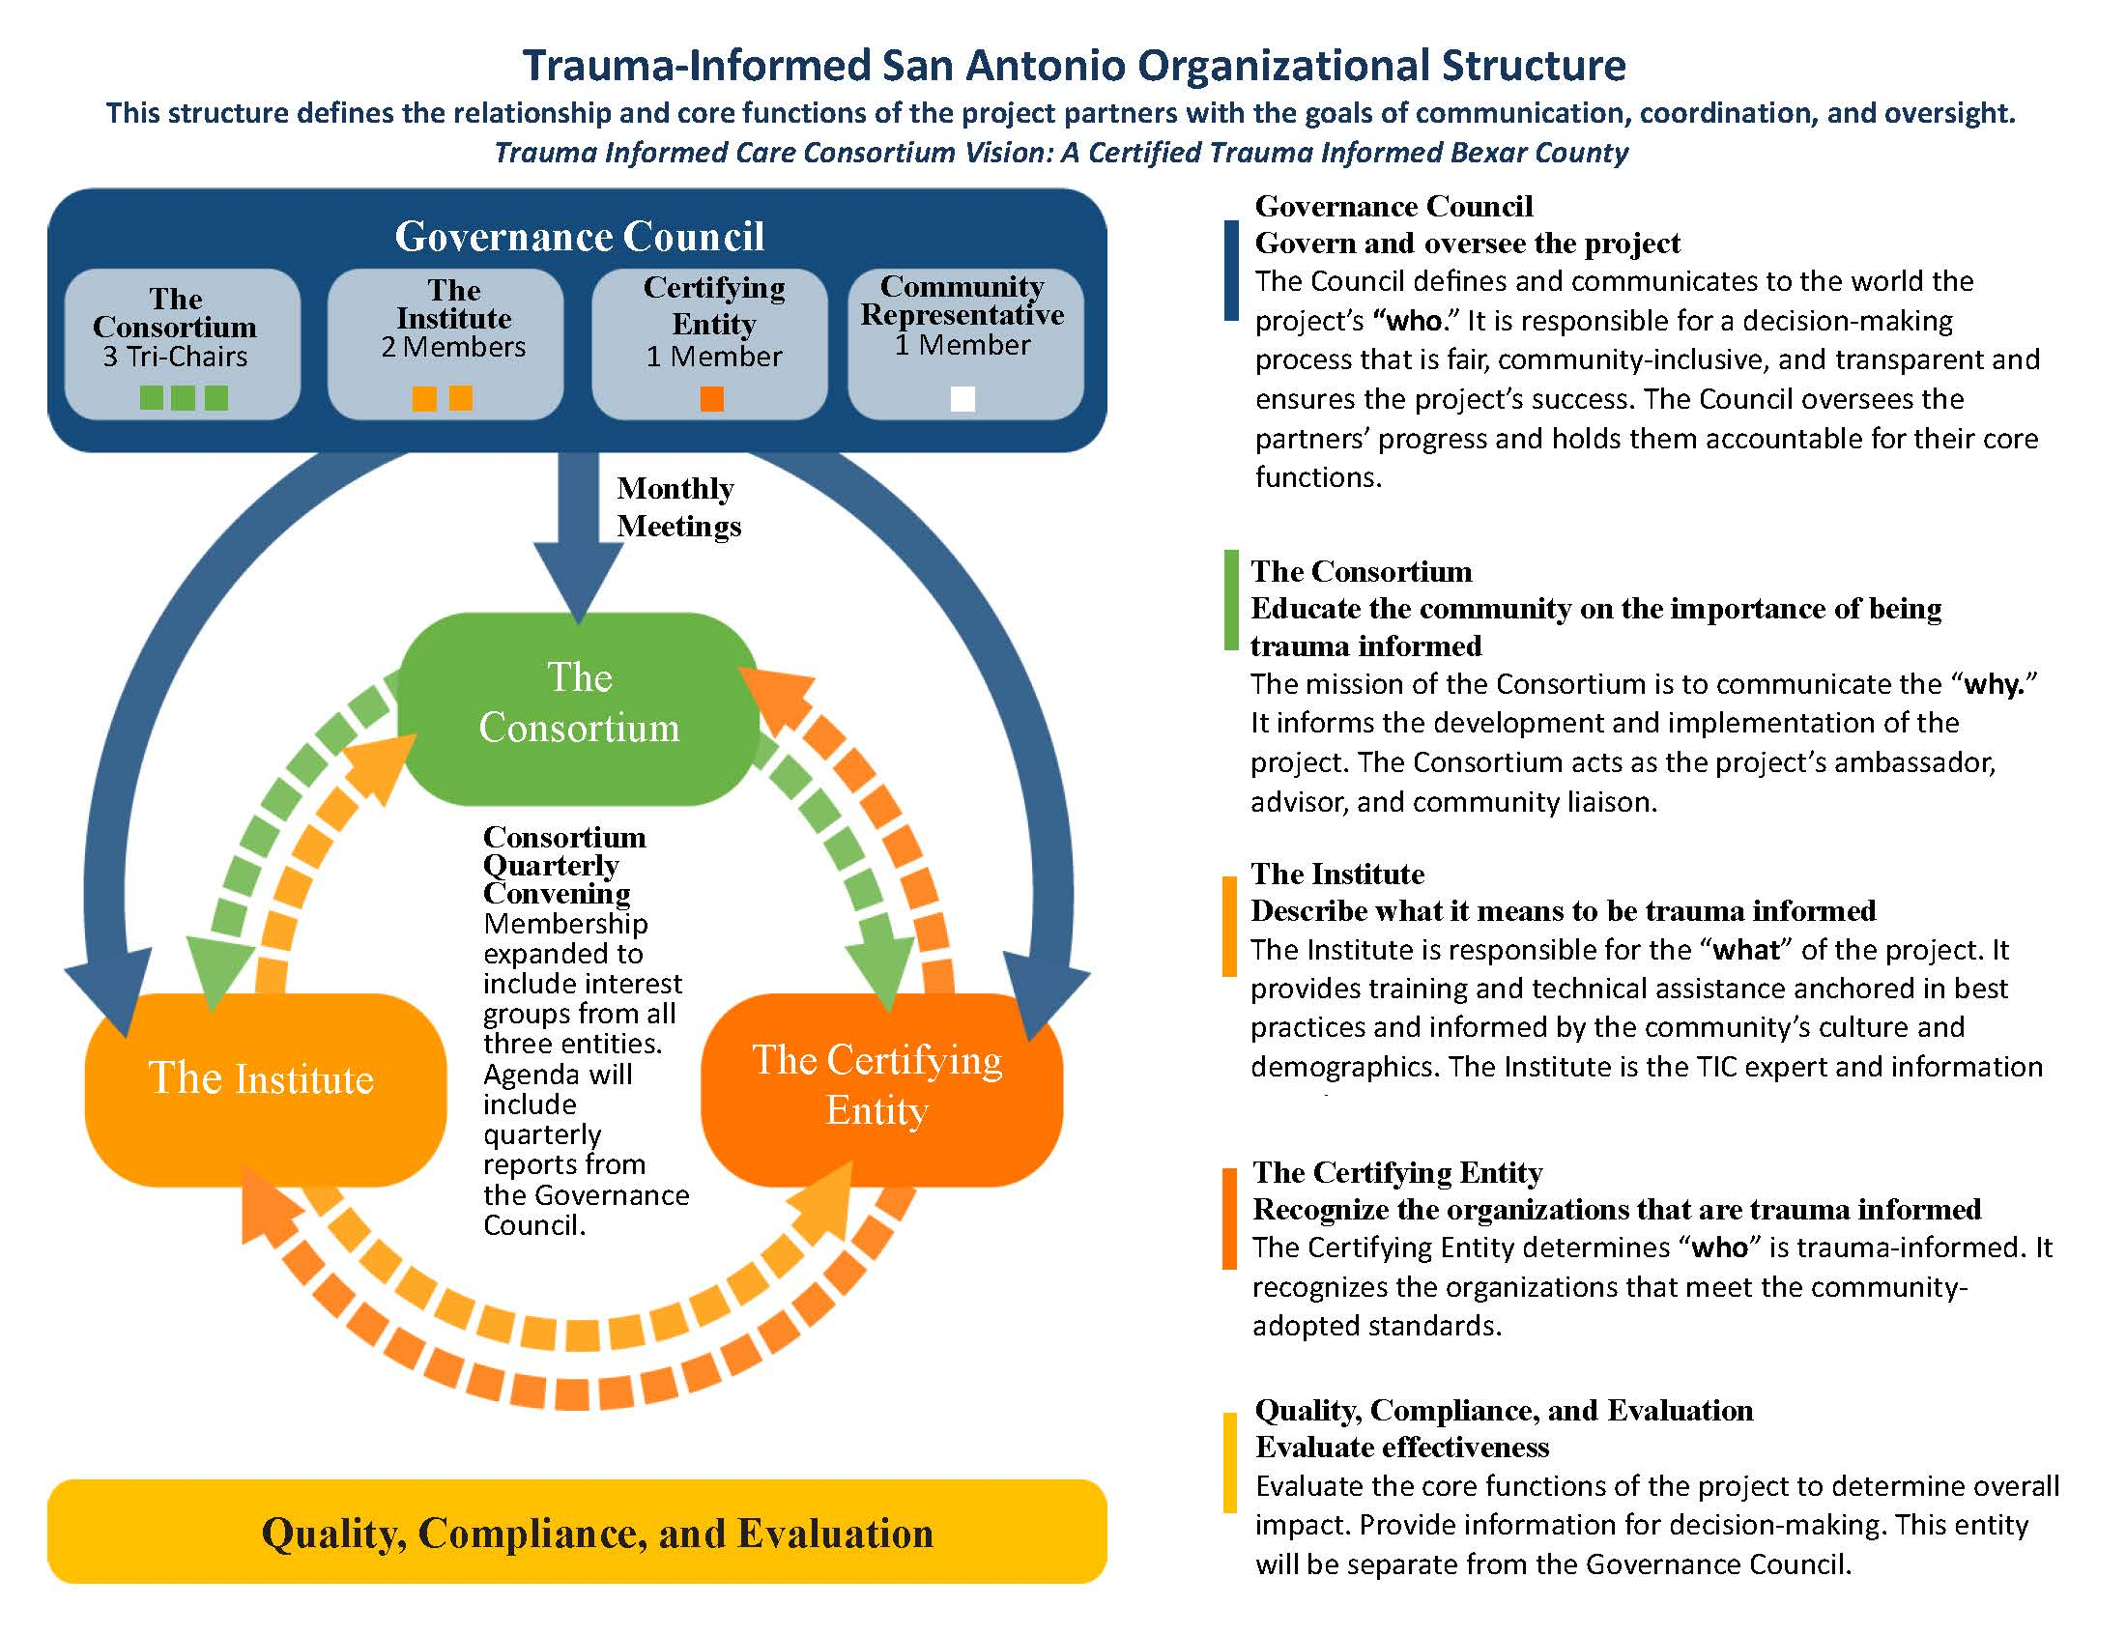

Slide 22
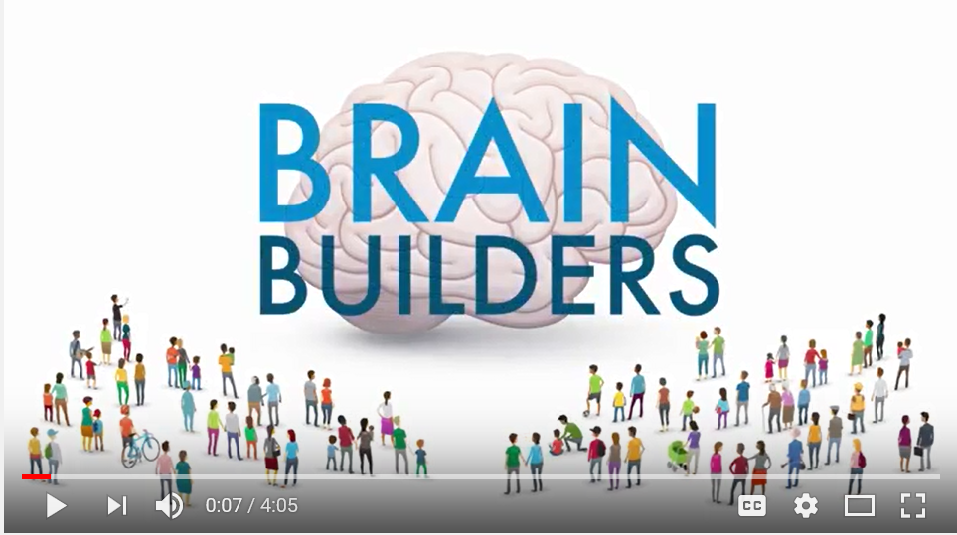
How Brains are Built
https://www.youtube.com/watch?v=LmVWOe1ky8s

Slide 23
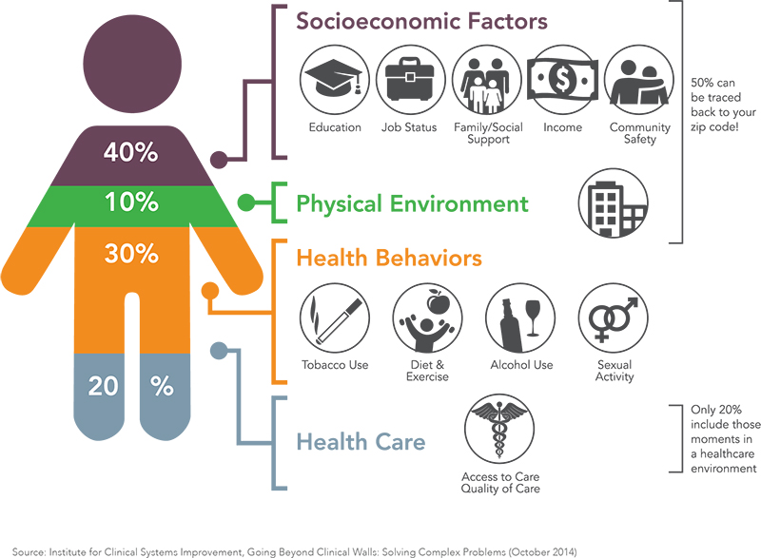
Social Determinants of Health
Source: Institute for Clinical Systems Improvement, Going Beyond Clinical Walls Solving Complex Problems. October, 2014.
23

Slide 24
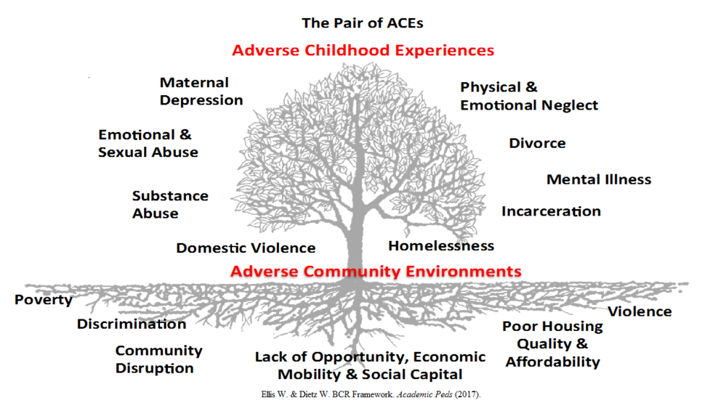
24

Slide 25
Colleen M. Bridger, MPH, PhD
Assistant City Manager
(210) 207-8706
Colleen.Bridger@sanantonio.gov

